Slide 1
Raising Attainment in a Department Through Creating the Right Learning Culture

Slide 2

In todays session we will….
  Establish your starting point – what is the learning culture like now?
  Explore 4 key factors to creating the right learning culture
  Work collaboratively to explore how these factors might be achieved
  Develop a department action plan, identifying 2 key areas to improve learning culture within your department
Notes:
2 minutes
Share delegates pack.

Slide 3
What do we mean by learning culture?
Notes:
There is plenty of research demonstrating aspects of learning culture to organisational outcomes, so for u, student attainment and staff satisfaction. One study found a significant direct relationship between learning culture and knowledge-sharing behaviors, with organisations who set up processes of sharing best practice had better outcomes.

Slide 4
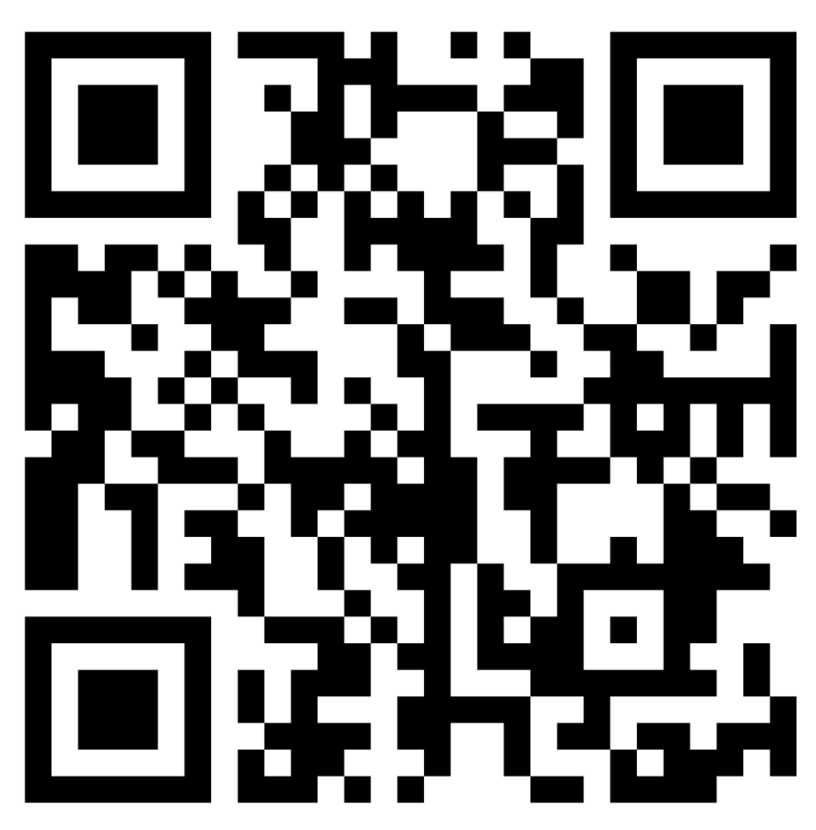
What do we mean by learning culture?
1 Create continuous, on-the-job learning opportunities, for all members.
2 Promote inquiry and dialogue: creating a culture in which feedback and experimentation are encouraged.
3 Encourage and reward collaboration and team learning.
4 Empower people toward a collective goal, using feedback from members to bridge the gap between the current status and the new vision.
5 Enable leaders to think strategically about how to use learning to create change and move the organisation in new directions.
Source: Watkins and Marsick (1993, 1996, 1997) 27, 28, 29
’A learning culture is one that embeds learning into how things are done at an individual, team and organisational level. This requires strong leaders to:
• Support individual learning and transformation, allowing this knowledge to shape strategy and process
• Encourage teams to learn and reflect on their work and proactively influence strategy and process change
• Have a willingness to learn and improve from the wider organisation.
Creating Learning Cultures, CIPD
So, what does your learning culture look like currently?
Notes:
There is plenty of research demonstrating aspects of learning culture to organisational outcomes, so for u, student attainment and staff satisfaction. One study found a significant direct relationship between learning culture and knowledge-sharing behaviors, with organisations who set up processes of sharing best practice had better outcomes.
https://padlet.com/nealawhybrow/lhovv71g05rw8ywo

Slide 5
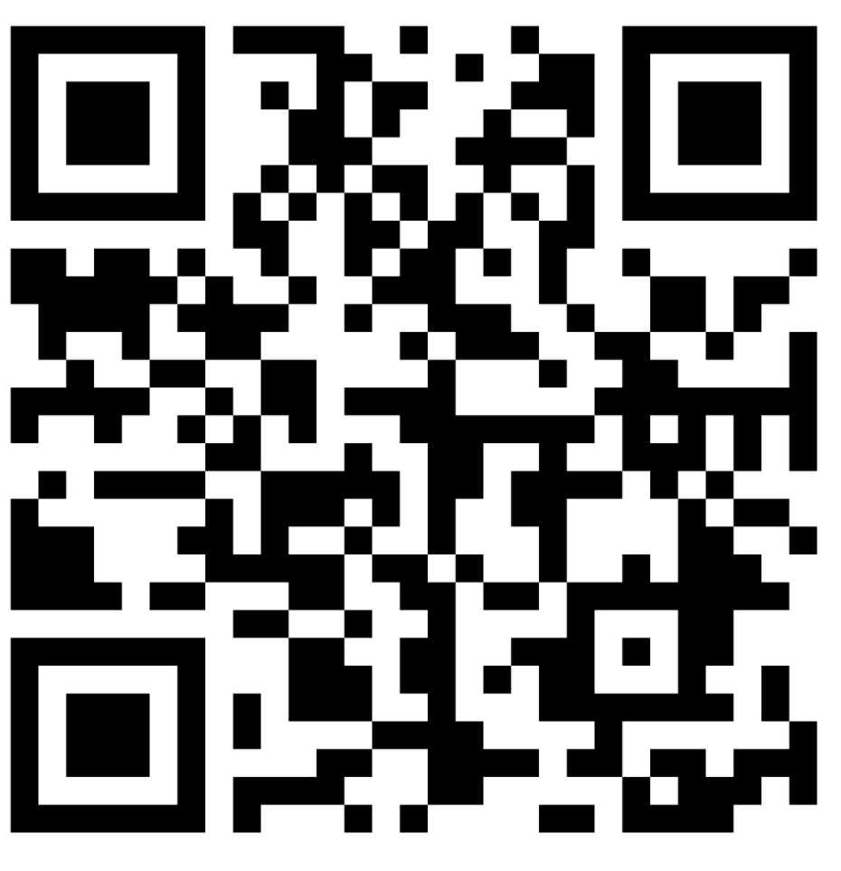
So, how could these pillars of learning culture be created?
Breaking off into 4 groups (1 pillar each)
Design an approach/system/process for achieving your given pillar of learning culture within your department.
Consider:
What will you change/add/adapt (and this may differ for different individuals within your team),
How will you go about introducing this (implementation),
How will you review the impact on learner experience/attainment?
What barriers/challenges do you anticipate?
How will you make it realistic, manageable and ensure it doesn’t negatively impact workload?
Notes:
https://padlet.com/nealawhybrow/3sjvur1wwowmgnqc
Use padlet on a shared screen to bring back discussion after about 20 minutes and discuss. As off in their groups, move around room/breakout rooms as well as add comments to the padlet to encourage deeper thinking.

Slide 6
Linking this to your learning culture and QIP priorities
Learning Culture approach (out of the 4 explored today) | Short term change (1 thing only) | Long term change (up to 3 things only) | How might this link to/support your QIP priorities? | Desired Impact?
Create continuous, on-the-job learning opportunities, for all members.
Encourage and reward collaboration and team learning
Notes:
Back into their small groups. Working independently however can share/seek support from their peers.
Attempts to structure informal learning could ultimately backfire if employees feel like they lack agency in their own learning and development, especially if they are already prioritising their own development. If creating a ‘culture for learning’ is interpreted as steering individuals to a fixed way of learning with little flexibility, this may not lead to better learning outcomes.
Use the template action plan in your delegates pack to develop a culture of learning action plan. It is important you think about doing this in baby steps and in a way which involves people. Attempts to structure informal learning could ultimately backfire if employees feel like they lack agency in their own learning and development, especially if they are already prioritising their own development. If creating a ‘culture for learning’ is interpreted as steering individuals to a fixed way of learning with little flexibility, this may not lead to better learning outcomes. Therefore, you are going to select only 2 of the pillars (the one you worked on and another you are drawn towards based on the presentation of your peers today). In order to not overwhelm your teams, think about 1 short term change (remember baby steps) and up to 3 long term changes. How might these link or support the priorities in your QIP and what do you anticipate would be the desired impact.

Slide 7
What support can the organisation give you to achieve this?
What can leadership do to support you in thinking strategically about how to use learning to create change and move the department in new directions?
Notes:
Senior leadership buy-in is key, so its absence can be a significant barrier. For example, 76% of L&D professionals in the CIPD Professionalising Learning and Development report felt that learning was not seen as a management priority. I would like to be able to get a sense of what is needed to support you with achieving this learning cuture, and hopefully after today you can see this isn’t just about buying in expensive consultants. Its building subject specific networks, cross college collaborations (and not just the EKC group) and wider reading. I would like to be able to share the finished padlet from today with SLTs to show them some of your ideas and aspirations for Learning Culture, so understanding what you may need from them will be key.

